Slide 1
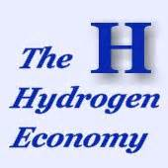

Unit 1

Slide 2
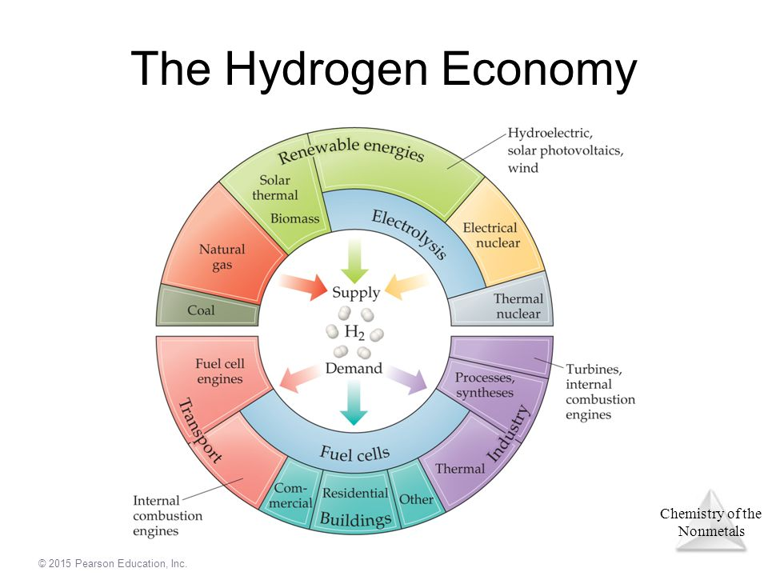

Slide 3
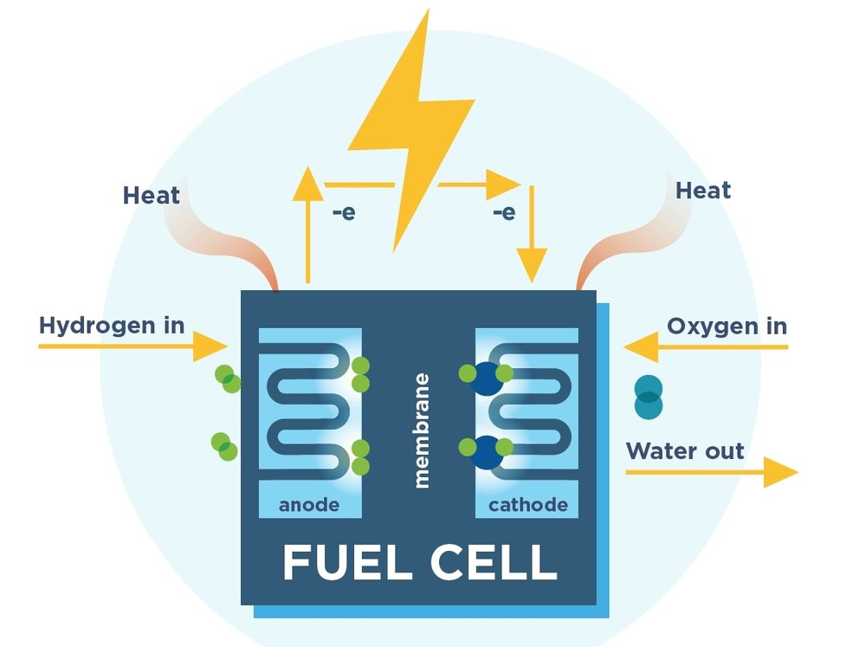
Text I Fuel Cell
What do you know about it?
How it works
Application
Benefits
Drawbacks
…

Slide 4
Text 1- Objectives
Summarize the history and current status of fuel cell technology;
Analyze the advantages and disadvantages of fuel cell powered vehicles;
Identify the author’s communicative purpose and the rhetorical strategies to achieve the communicative purpose;
Identify the discourse pattern of the article

Slide 5
Writing strategies
Reading preparation
Communicative purpose :
Convey information
Express an opinion
Prove a claim
Solve a problem
Propose a theory
Debate an issue
Report an experiment
…
Make a list of purposes you may have when you are producing a piece of writing.

Slide 6
Reading preparation
Discourse pattern(ways of organizing the information)
Chronological order
Space order
Classification
Cause-effect
General-particulars
Problem-solution
Hypothesis-testing
Comparison & contrast
…

Slide 7
Writing strategies
Reading preparation
Rhetorical strategies
Explanation/definition
Description
Recount/narration
Exemplification
Evaluation
Prediction
quotation
…

Slide 8

Reading preparation
Think about:
The purpose of the article;
The way of organizing the information.
The rhetorical strategies used to achieve the purpose;

Slide 9
Text I Fuel Cell---Structure
Skim through the text and summarize the main idea in one sentence for each section.

Slide 10
Text I Fuel Cell---Structure
Subheadings | Main idea
Opening section | The significance of fuel cell technology
The Gas Battery | the origin and development of fuel cell technology and its application in vehicles in the 19th and the first half of 20th century.
Electric Car Resurgence | the development of various types of fuel cells and the story of the Ballard Power System on developing fuel cell bus.
Into the Mainstream | the status of fuel cell cars and their advantages
Out of the Laboratory, Someday | the prospect and practical problems to be solved of the application of fuel cell vehicles
Fuel-Cell Phone | the applications of fuel cells in consumer electronics and its promising future

Slide 11
Text I Fuel Cell---Structure
I have read and clipped … and have generally become increasingly interested in the history, status and future of the technology.
Opening section
The Gas Battery
Electric Car Resurgence
Into the Mainstream
Out of the Laboratory, Someday
Fuel-Cell Phone
History
Status
Future

